Slide 1


Design End users / Content Admin | April 26, 2023
CONTENT-FIRST DESIGN
How to make sure your site lives up to expectations
Adrienne Smith
Senior Digital Strategist
linkedin.com/in/adrienne-julie/
Notes:
Hi everyone and thanks for being here! I’m really excited to be participating in my first ever Drupal event.
Let’s get into it! I’ll be talking about content-first design, but even that is a misnomer. I’m going to discuss the many advantages gained by not relegating content strategy to the backseat of our web design & development projects, explaining concretely what content strategy is; how it not only fits into the process of web projects but can actually save time & money by being conducted in hand in hand with other activities rather than being run in parallel or after the fact.
Description
You're about ready to launch your new website - great! But what about the content? As web design has shifted to place more importance on a delightful user experience via features and functionalities, it’s easy to save the nuts and bolts of content strategy for the end of a project. From aligning your content with business goals and user needs, to organizing it for findability, keeping it up to date, expressing your brand identity...don't leave this part to chance! By leveraging opportunities throughout the discovery, design, development and post-launch process, you can easily ensure that your website content is contributing to (and not hurting!) our objectives and user needs.

Slide 2

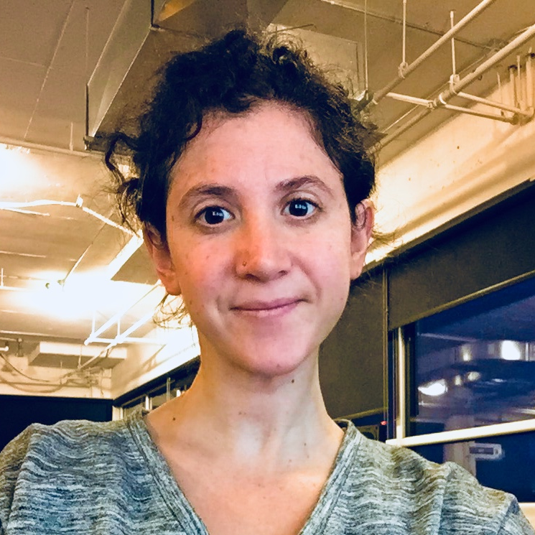
Hello!
Adrienne Smith
Senior Digital Strategist
10+ years’ experience designing digital content strategies
Expertise in information architecture, taxonomies, metadata & content governance

Slide 3
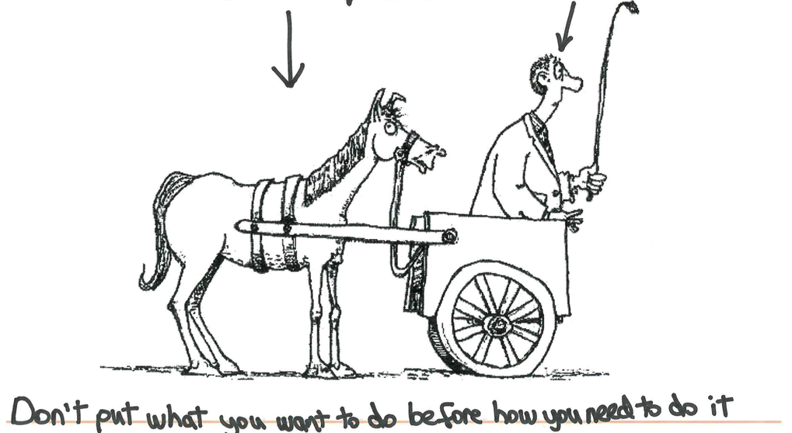
Web design
Content strategy

Slide 4
Agenda
The design process
Context
Adding content strategy
What, how & why
Two birds, one stone
A complementary process

Slide 5
THE DESIGN PROCESS
CONTEXT

Slide 6
Process
Design & Test
DISCOVERY
OPERATIONALIZE
DESIGN & TEST
GOVERN

Slide 7
Process: Discovery
conduct research to understand objectives, needs and gap between the current and target states

Slide 8
Process: Discovery
What are users trying to do on the site?
What are our business goals?
What is working today? What’s not working?
What’s a typical user journey?
What needs, pain points & opportunities can we identify along the way?
How will we measure success?

Slide 9
Process: Design & Test
based on discovery outcomes, develop & iterate on concepts to bring the strategy to life

Slide 10
Process: Design & Test
How could we organize content to improve task completion?
How could we enhance the user experience to support objectives?
What visual design or editorial voice best manifests our brand and speaks to our users?

Slide 11
Process: Operationalize
flesh out the tested concepts, seeing how they all work together

Slide 12
Process: Operationalize
What is the status of everything we have to do? What do we have left?

Slide 13
Process: Govern
continuously maintain your product, adjusting according to performance, outcomes & accomplishment of objectives

Slide 14
Process: Govern
Post-launch, who will do what, when to ensure that the site is continuously meeting business goals and user needs?

Slide 15
ADDING CONTENT STRATEGY
WHAT IS CONTENT STRATEGY, ANYWAYS?

Slide 16
Content Strategy: What
“connects your organization’s content efforts with business goals and needs”
“plans for the creation, publication, and governance of useful, usable content”
“use words & data to create unambiguous content that supports meaningful, interactive experiences”
Brain Traffic,
Kristina Halvorson
A List Apart,
Kristina Halvorson
Boxes and Arrows,
Rachel Lovinger

Slide 17
Content Strategy: What
STORYTELLING
Connecting users to content that engages them
MARKETING
Achieving business goals by communicating to users
WAYFINDING
Making information accessible to all users, at the right time & place, and in the right format

Slide 18
Content Strategy: How
BACK STAGE
FRONT OF HOUSE
Content inventory
Content audit
Content governance
Information architecture
Navigation
Content model
Style, voice & tone guidelines

Slide 19
Content Strategy: Why
Answer the BIG questions:
“What’s the big idea?”
“Why does our website exist?”
“Who are we trying to reach?”
“How will we measure success?”
Brain Traffic, Scott Kubie

Slide 20
TWO BIRDS, ONE STONE
A COMPLEMENTARY PROCESS

Slide 21
Process + Deliverables
Design & Test
DISCOVERY
OPERATIONALIZE
DESIGN & TEST
GOVERN

Slide 22
Discovery Deliverables
Current state: content inventory + audit, UX heuristic evaluation, research, analysis, benchmarking & requirements gathering
User journey mapping: what content do users need at each step of their journey? What’s missing or sub-par?
Strategy: what course of action will we take to achieve our goals?

Slide 23
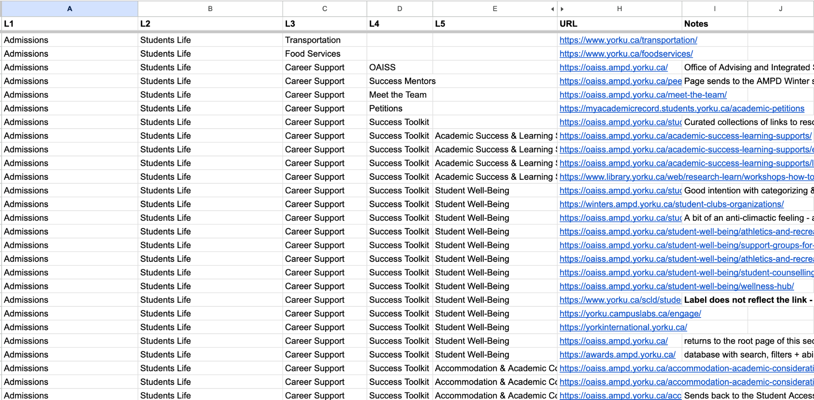
Content Inventory + Audit

Slide 24
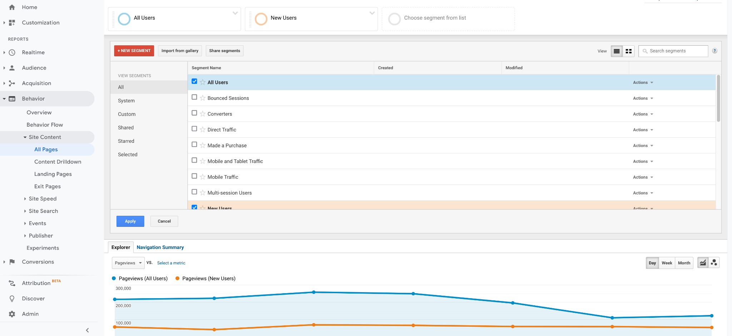
Analytics Assessment

Slide 25
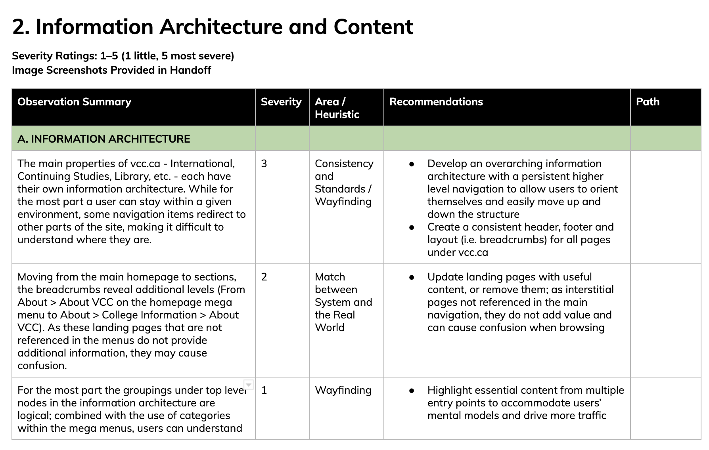
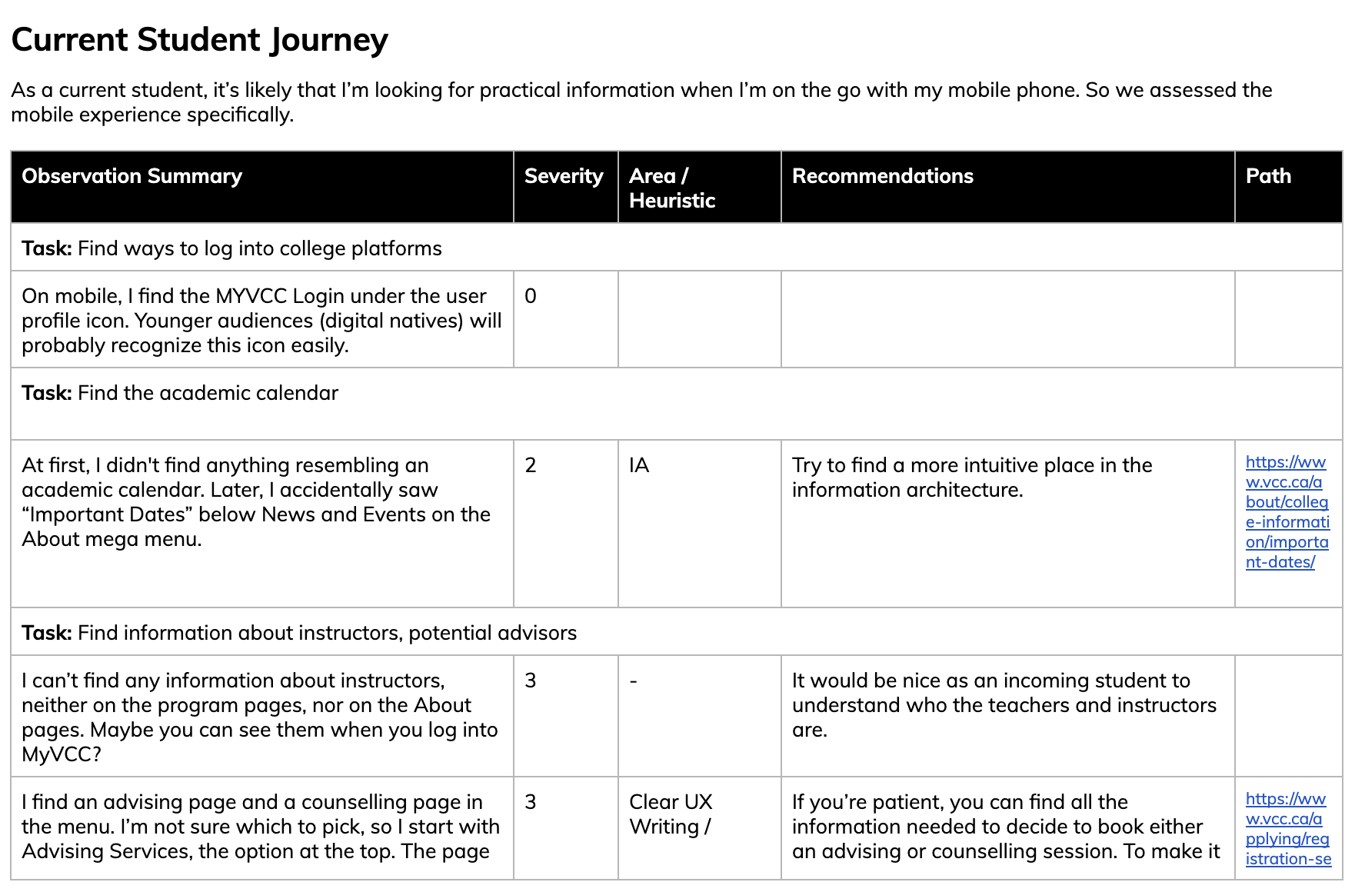
Heuristic Evaluation

Slide 26
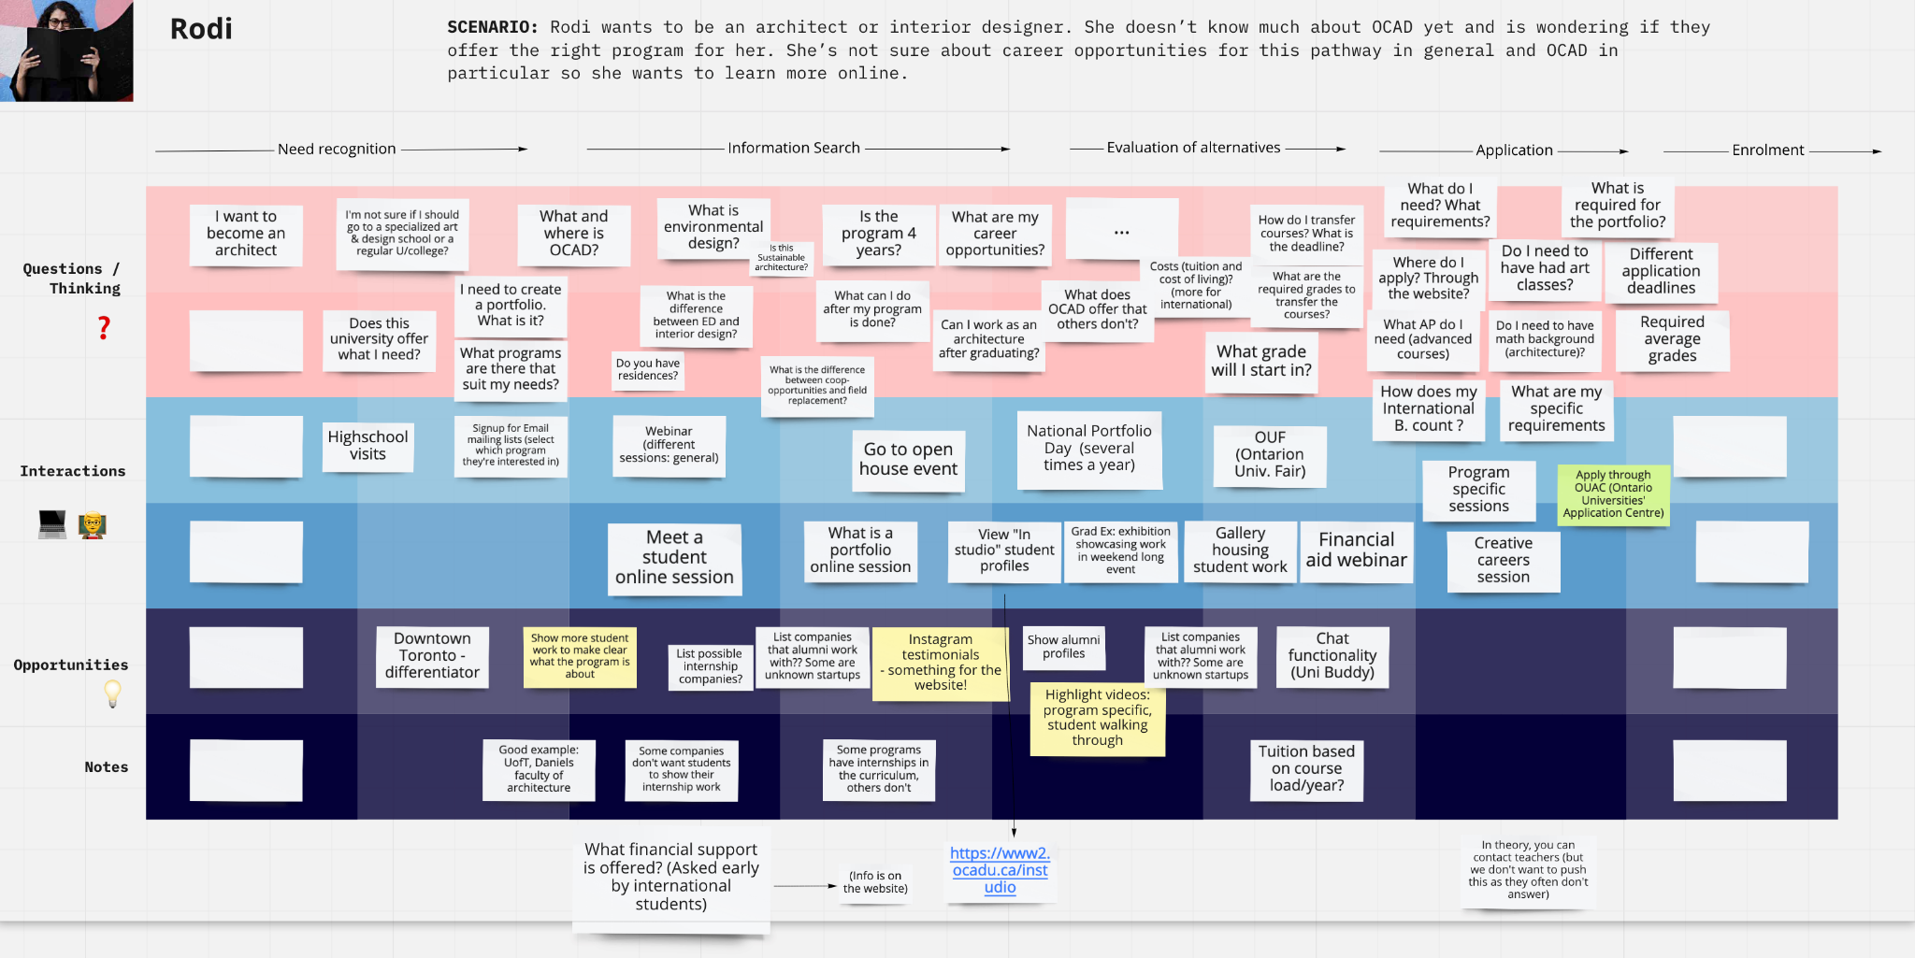
User Journey Mapping

Slide 27
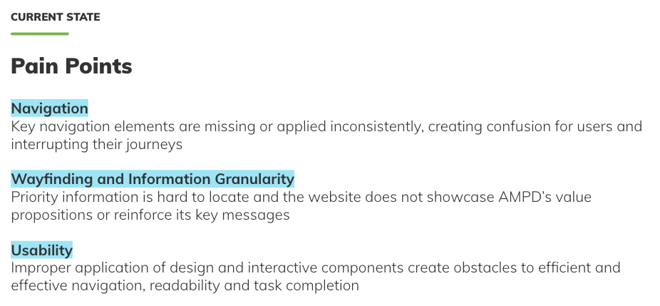
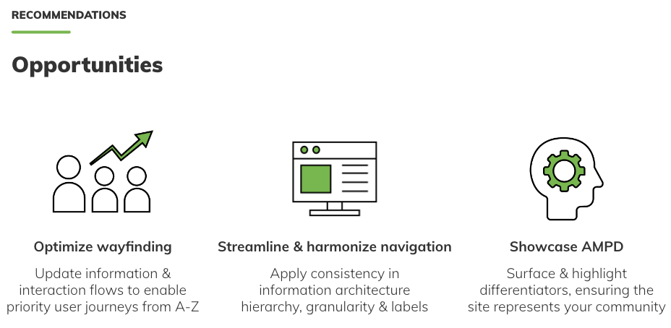
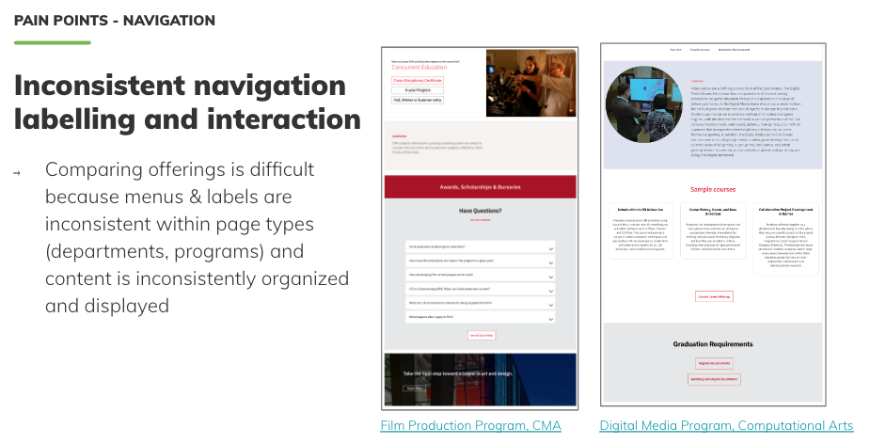
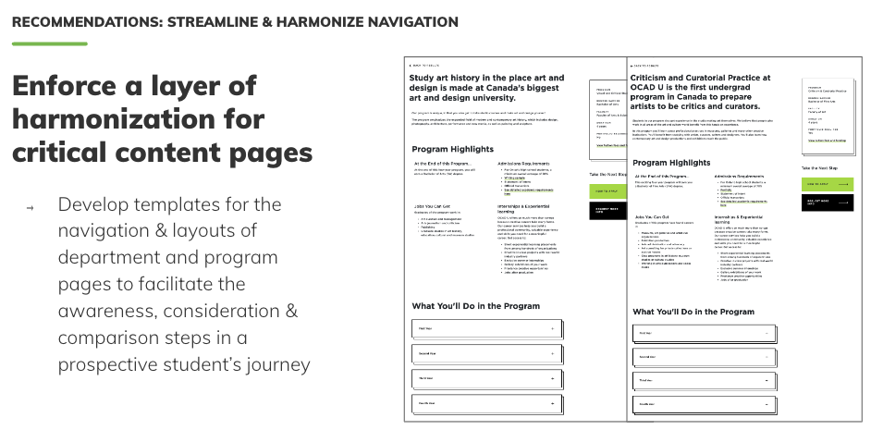
Findings Summary
Diagnose & summarize main
pain points to address
Consolidate opportunities & develop the redesign strategy

Slide 28
Strategy
Goals | Recommendations
Clear CTAs: Increase conversions (number of applicants) Reduce phone calls | 1-2 CTAs per page Primary CTAs to book: Online info session Meet a Student/Grad Virtual appointment Secondary CTAs: Join mailing list Download viewbook

Slide 29
Strategy
Goals | Recommendations
Program selector: Demonstrate that programs are multidisciplinary Invite students to try on different hats or expand their options | Show all the programs by default Show a fixed set of attributes associated with the programs Allow students to mix and match attributes

Slide 30
Design & Test Deliverables
Content model: what structure will best serve our content publishing needs?
Information architecture + navigation: what information organization will best suit our user needs & business objectives? What elements should be shown, where, to accompany users on their journeys?
Wireframes: how will the needed components - content, features, functionalities - be laid on our our site?
Style, voice & tone guidelines: who are we as an organization, and how does our content reflect that?

Slide 31
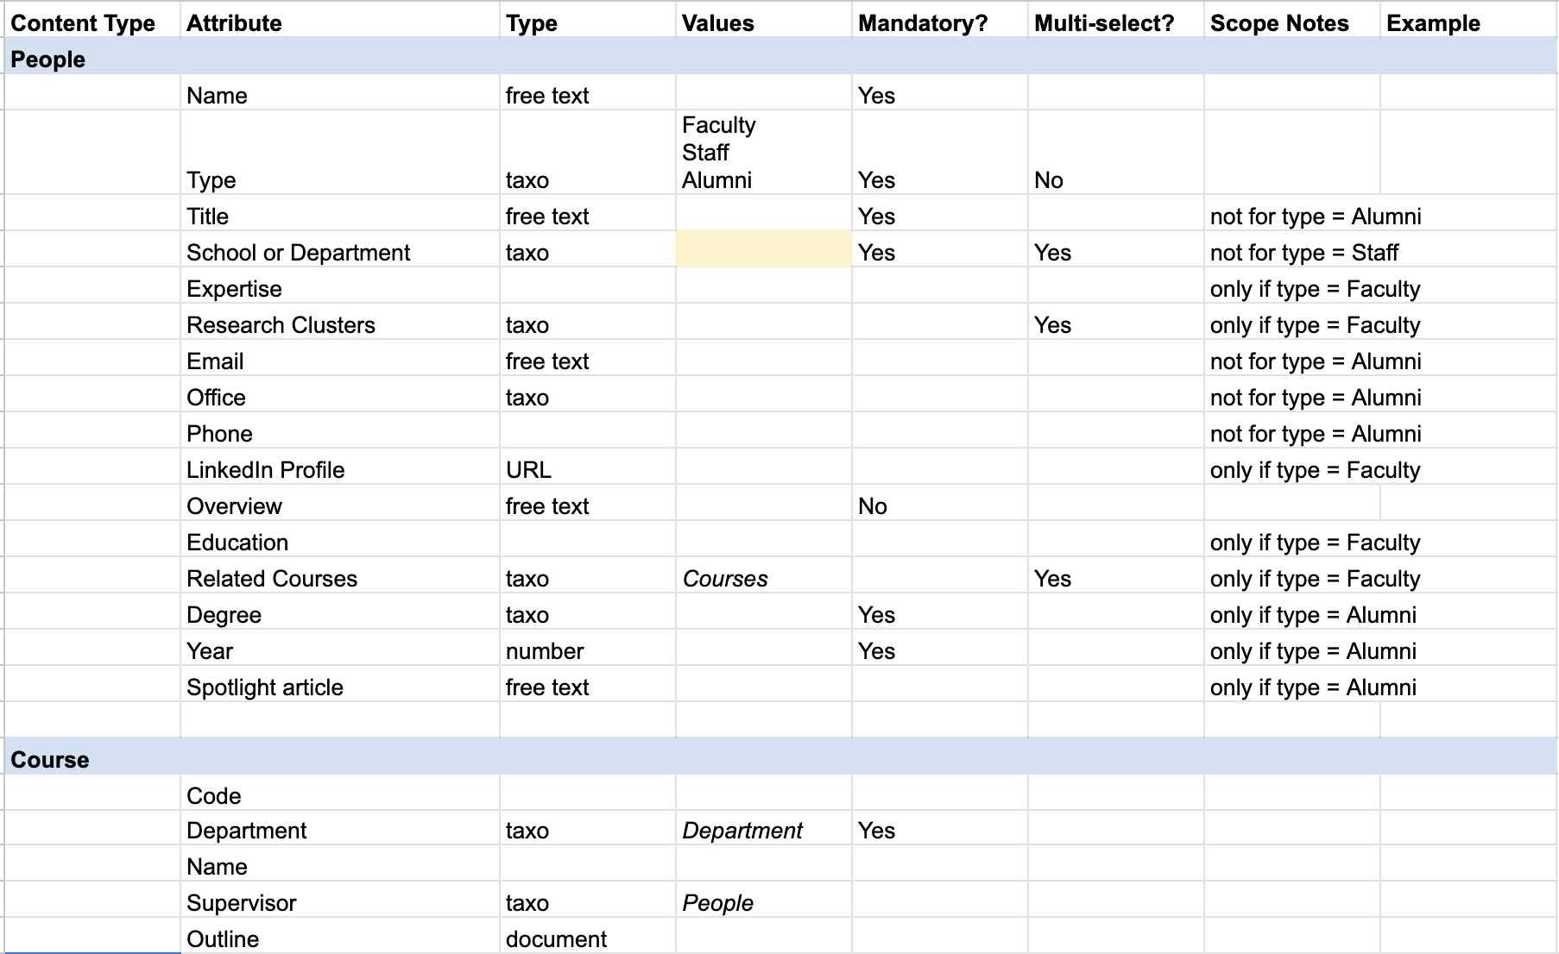
Content Model

Slide 32
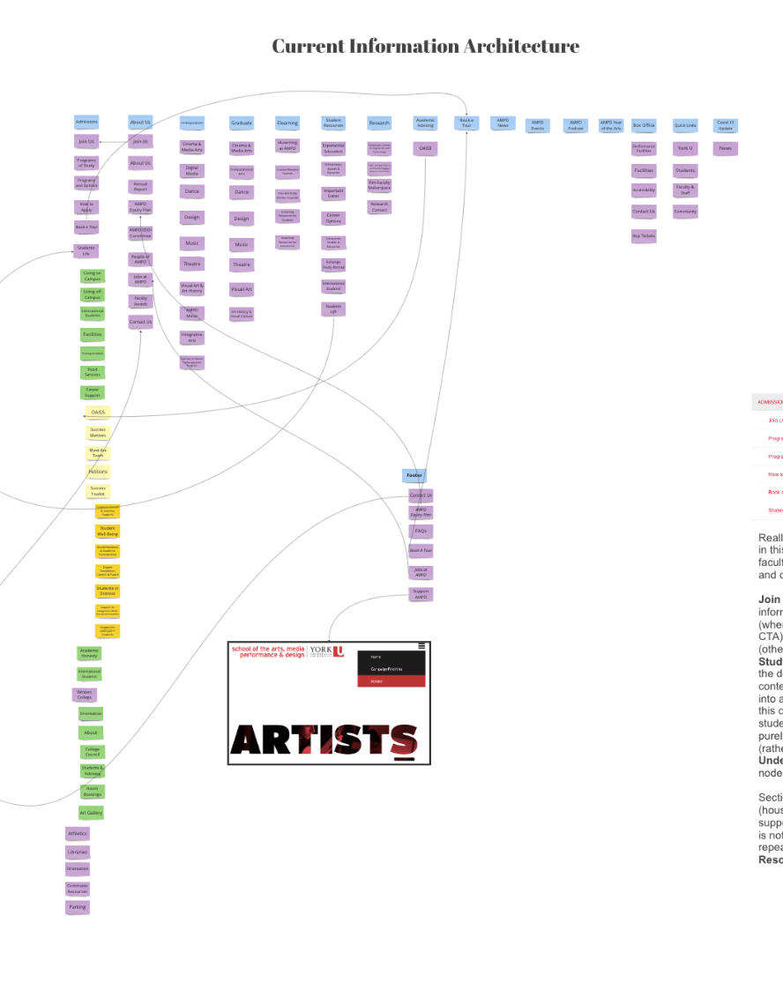
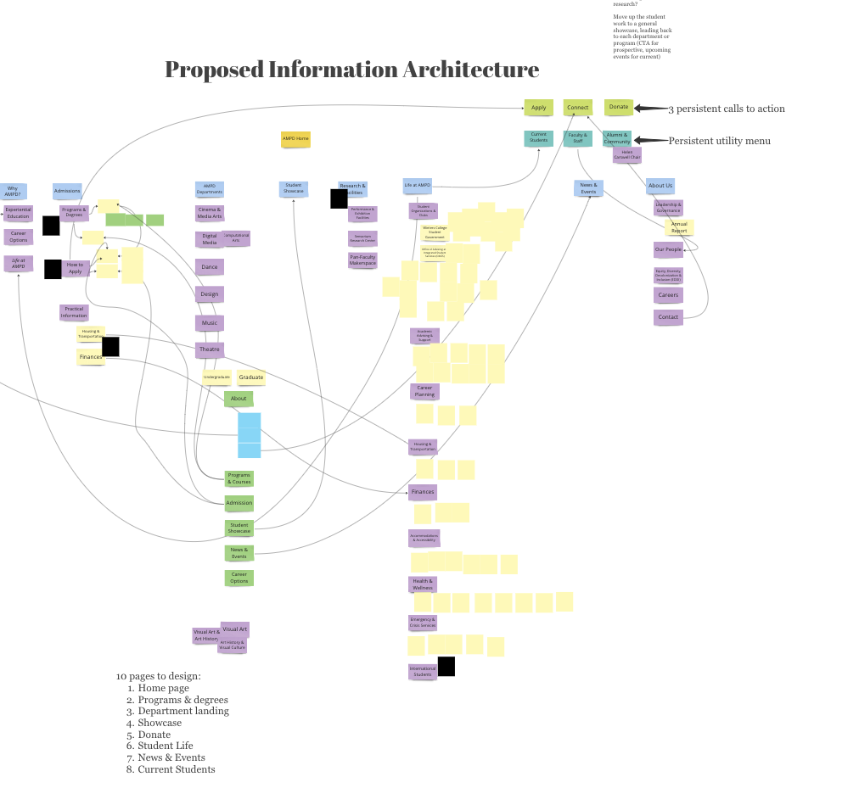
Information Architecture + Navigation

Slide 33
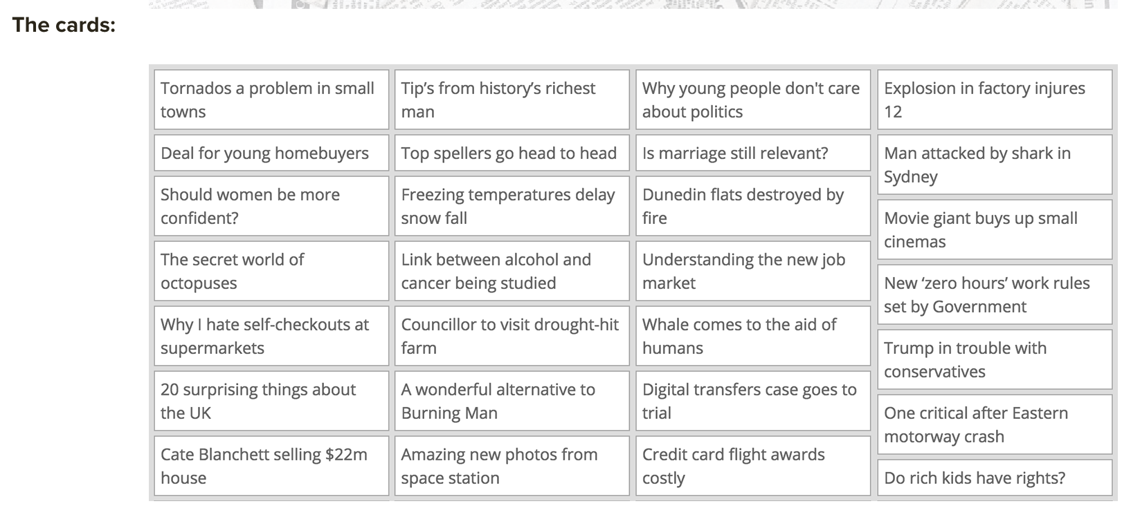
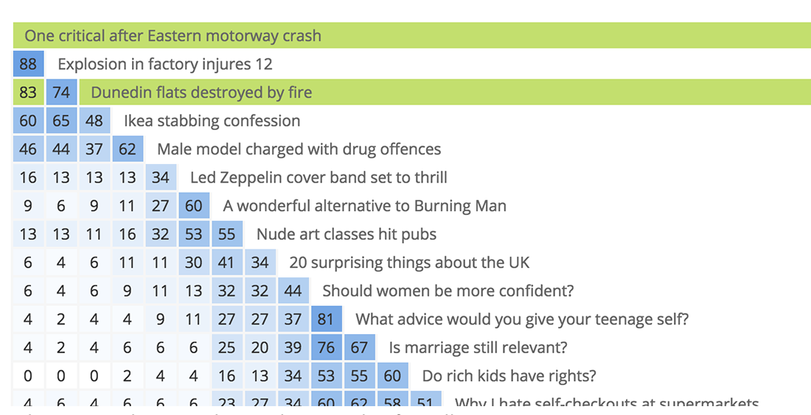
Card Sorting

Slide 34
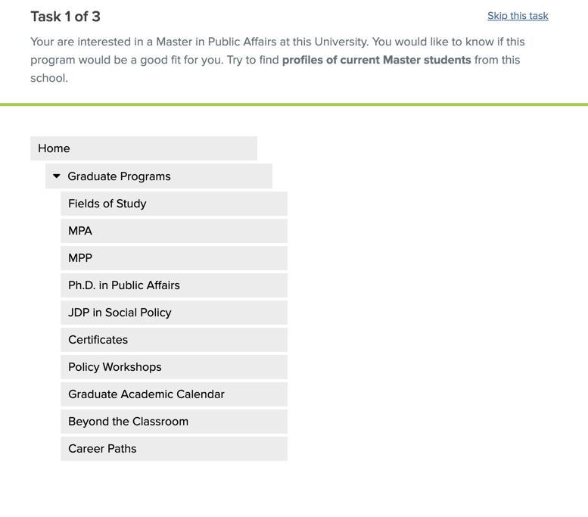
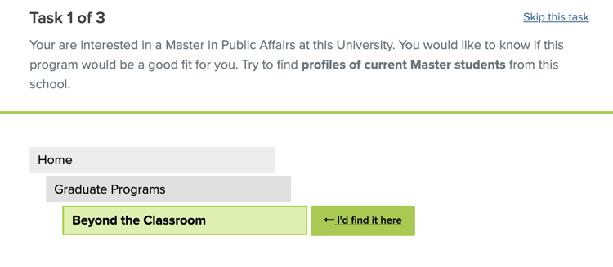
Tree Testing

Slide 35
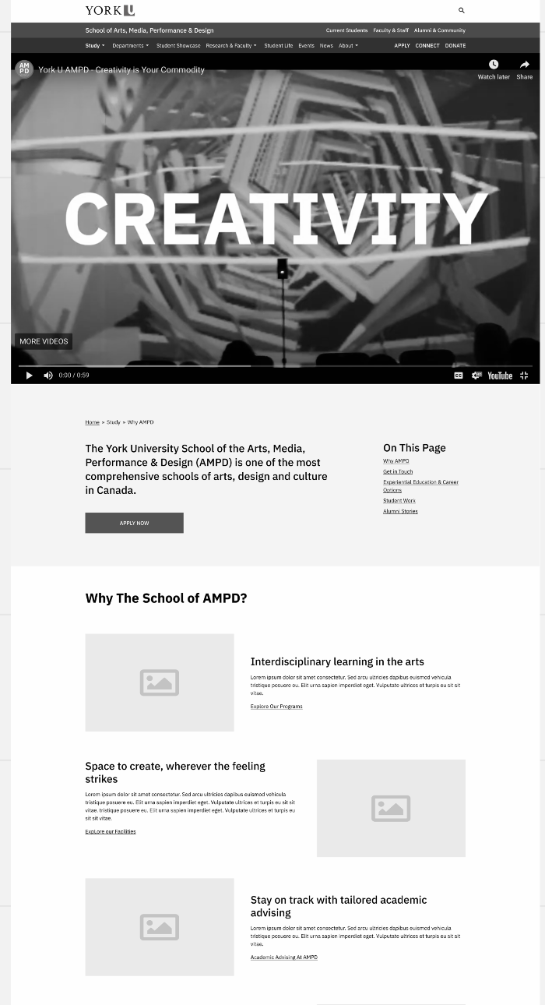
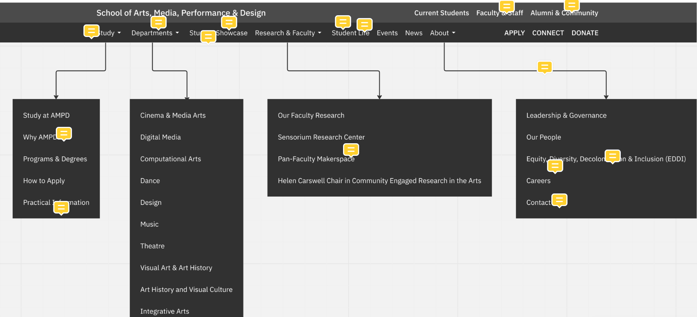
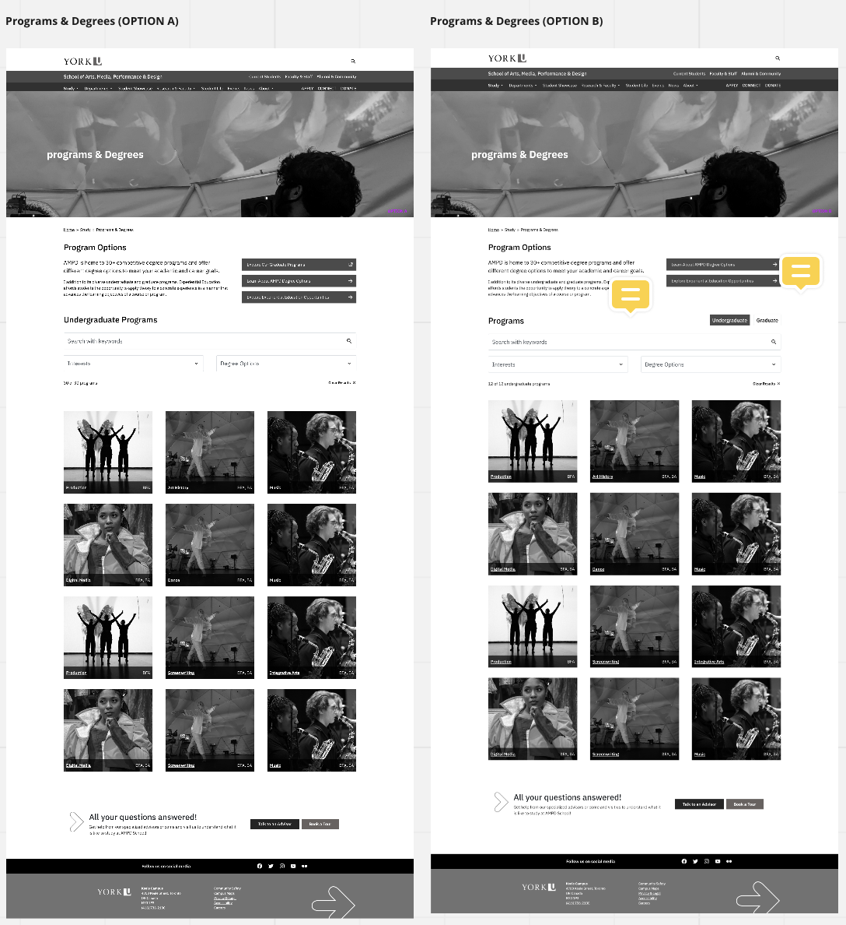
Wireframes

Slide 36

Style, Voice & Tone Guidelines
Voice is Human.
It’s familiar, friendly & straightforward.
Our priority is explaining our products
and helping our users get their work
done so they can get on with their lives.
We want to educate people without patronizing or confusing them.
What it is, and what it isn’t:
Fun but not silly
Confident but not cocky
Smart but not stodgy
Informal but not sloppy
Helpful but not overbearing
Expert but not bossy
Weird but not inappropriate

Slide 37
Style, Voice & Tone Guidelines
Attribute | This means… | Do | Don’t
Professional | We respect and value our audiences, and take what we do seriously. | Use respectful language Provide sufficient information for understanding Keep content updated | Use jargon Talk down to the audience
Collegial | We treat our audiences as valued partners, and are willing to work together to help them succeed. | Keep a user focus Use first/second person (we, you) | Write from an organizational perspective Use bureaucratic language Use the passive voice

Slide 38
Voice Dimensions
Casual
Neutral
Formal
Funny
Neutral
Serious
Enthusiastic
Neutral
Matter-of-fact
Irreverent
Neutral
Respectful

Slide 39
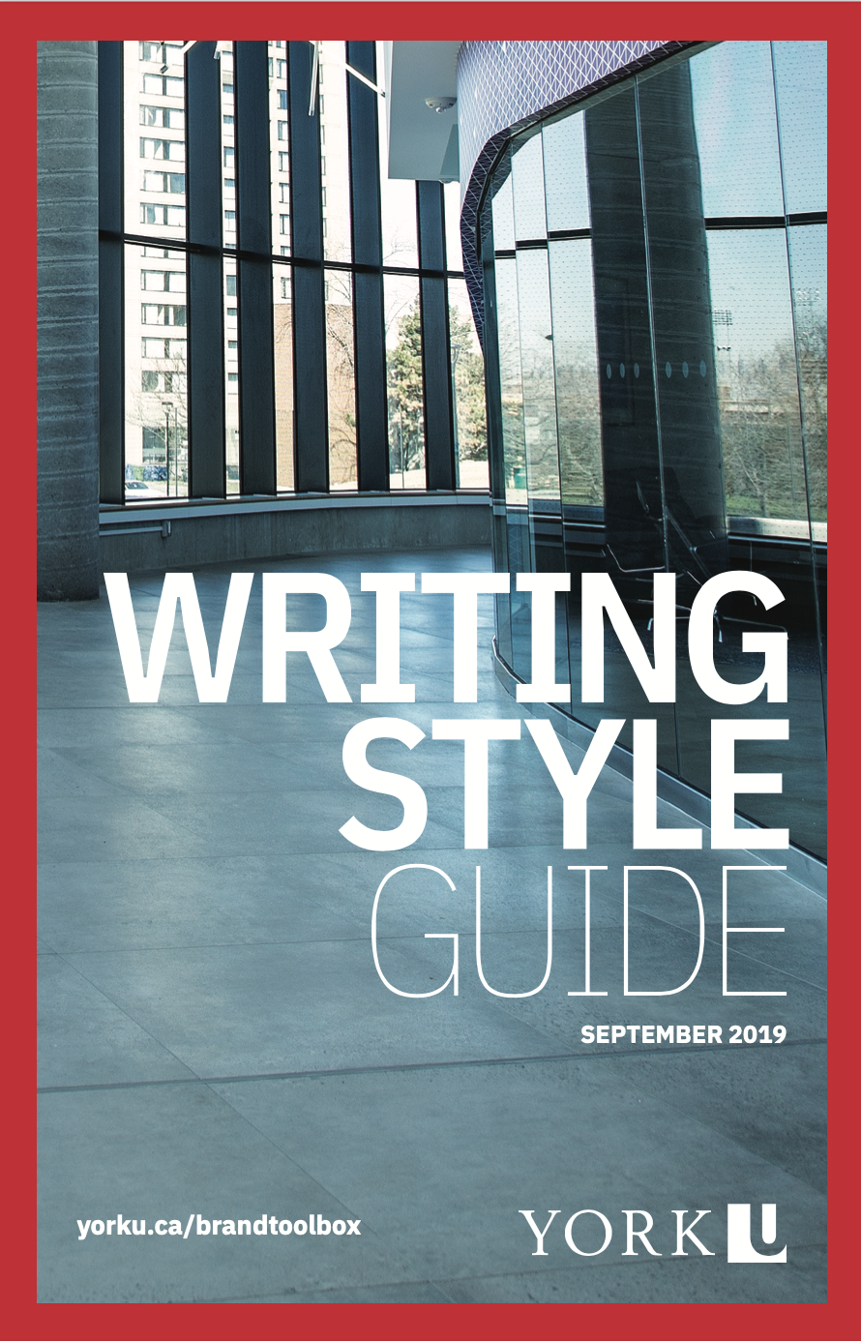
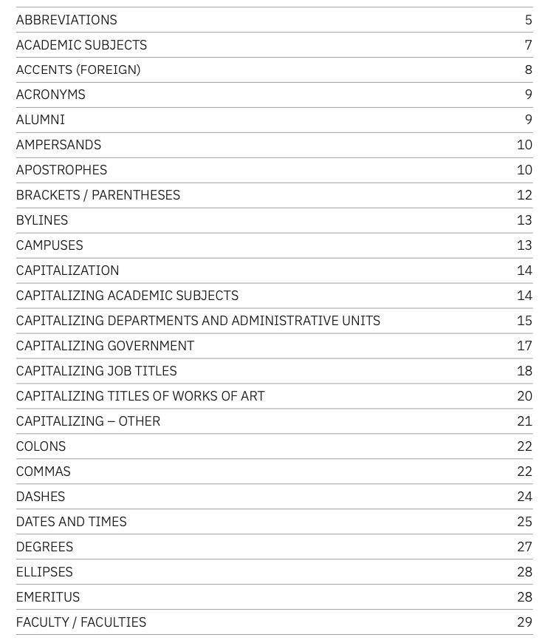
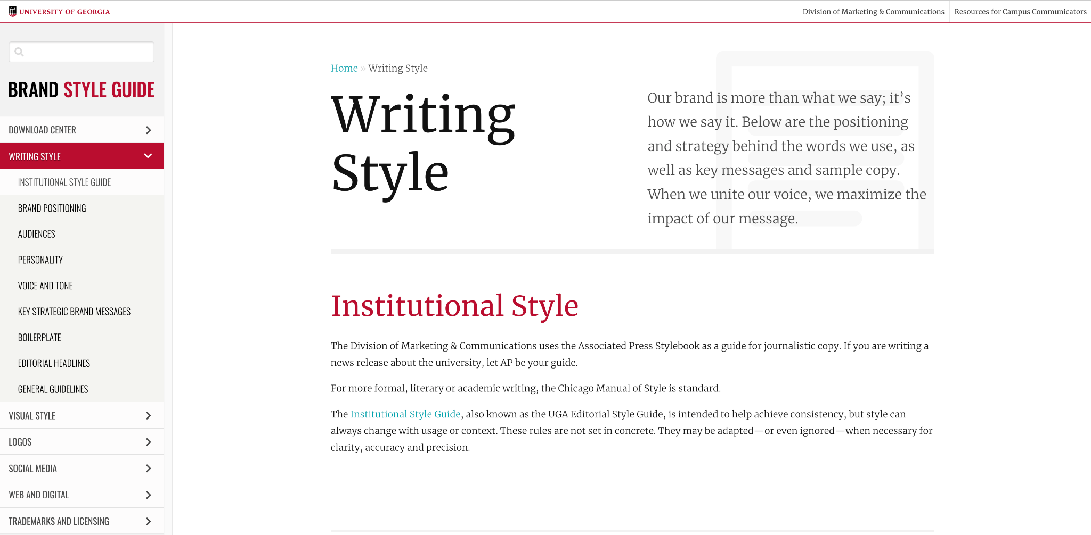
Style Guide

Slide 40
Operationalize Deliverables
Content tracker: what content do we need to rewrite? What do we need to create? What will it look like? How will we measure compliance?

Slide 41
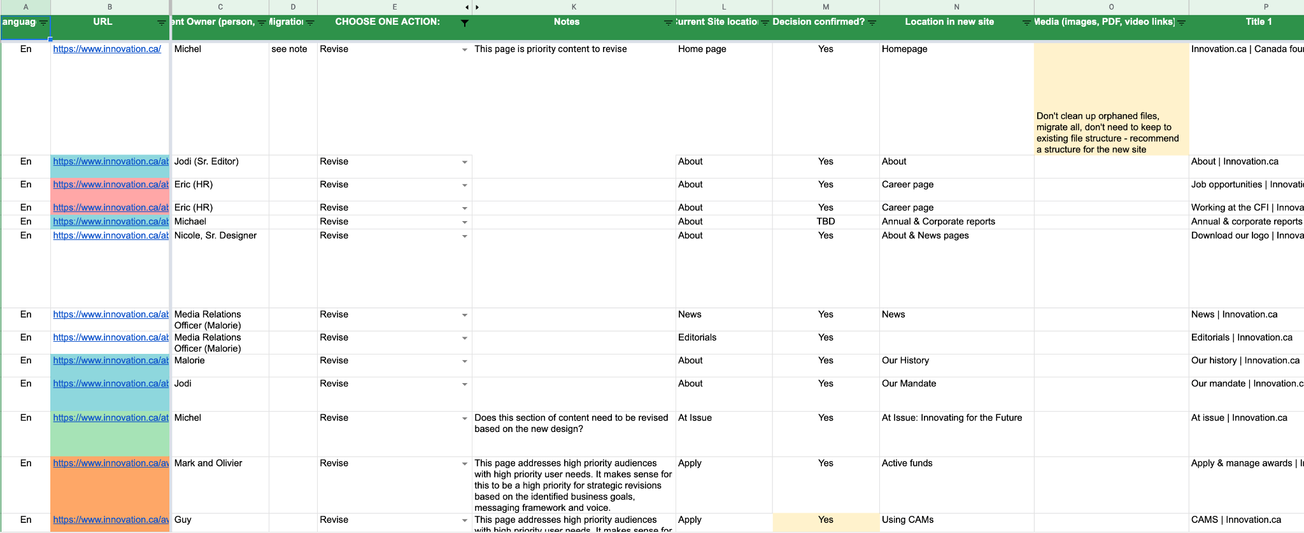
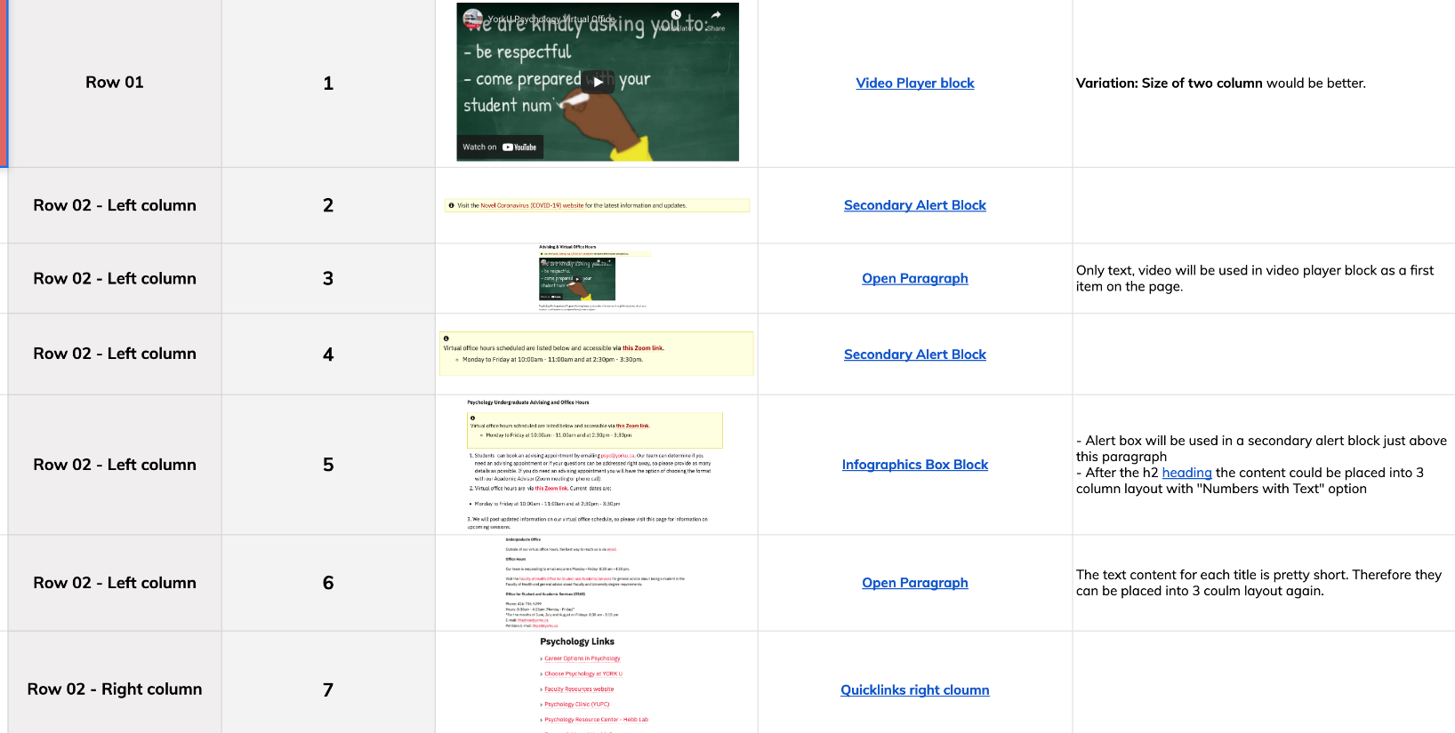
Content Tracker

Slide 42
Govern Deliverables
Content governance: who will be responsible for creating, updating, approving, publishing & retiring which content? On what schedule? Using which tools?

Slide 43
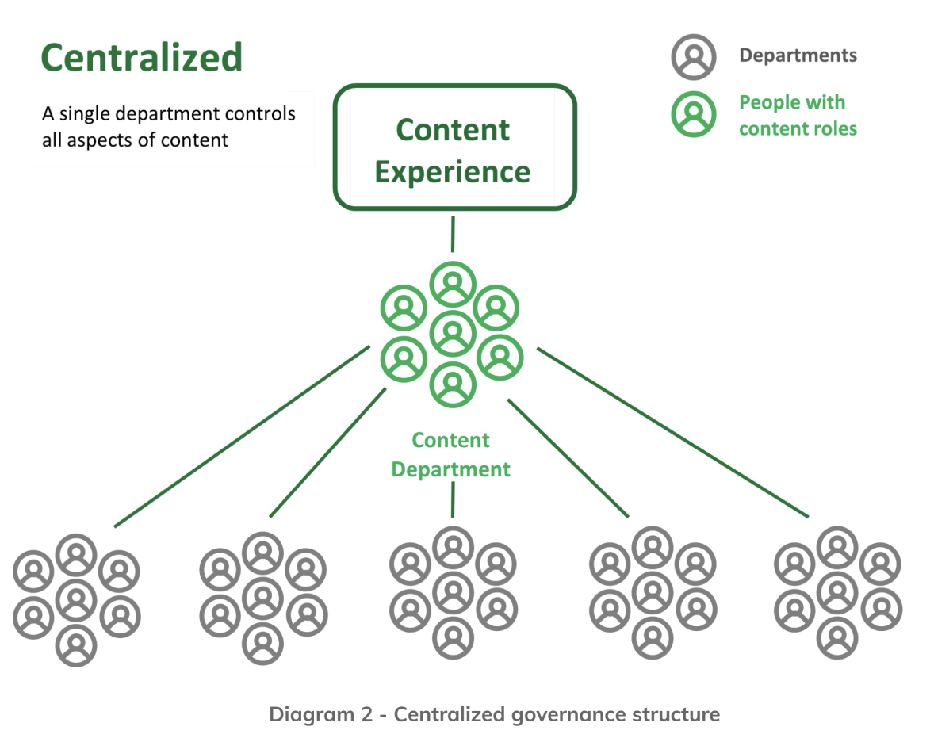
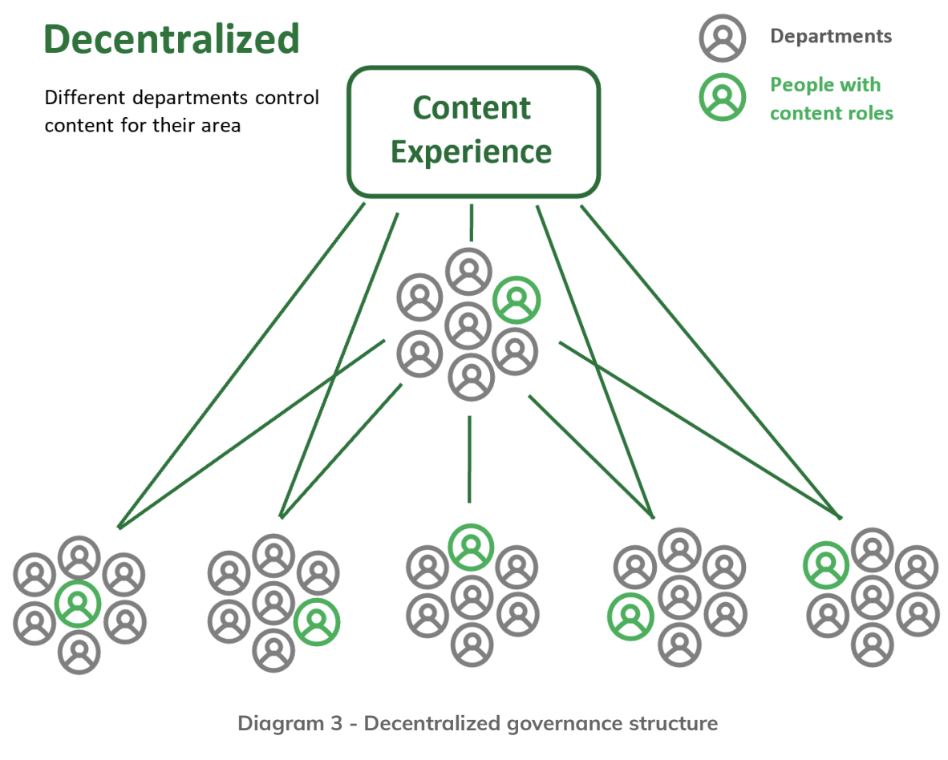
Content Governance

Slide 44
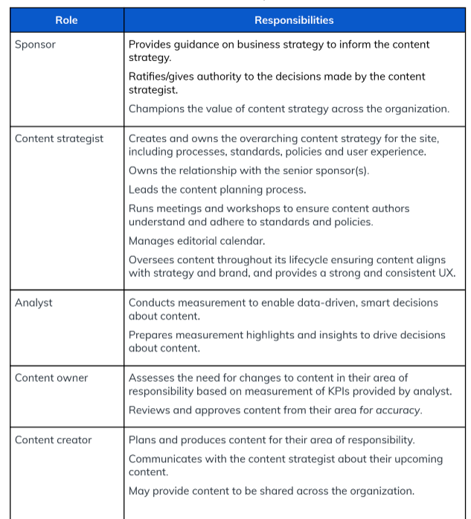
Content Governance

Slide 45

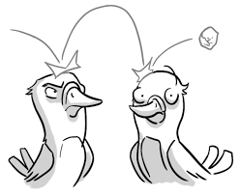
Key Takeaways
Want to know more?
Collaborate with us?
Get in touch!
linkedin.com/in/adrienne-julie/

Slide 46
THANK YOU!
QUESTIONS?

Slide 47
PLEASE PROVIDE YOUR FEEDBACK!
mid.camp/7049

